Slide 1

Prediction of Smart Phone Addiction Among Students Using Gradient Boosting Algorithm
by
P. Vasundhara
Roll No. 214G1A33B6
B. Sruthi
Roll No. 214G1A33A5
M. Subahan
Roll No. 224G5A3312
K. Santosh Kumar
Roll No. 214G1A3390
Under the guidance of
Mr. K. Kondanna,_{M.Tech(Ph.D)}
Assistant Professor
Department of Computer Science and Engineering (AI & ML)
Srinivasa Ramanujan Institute of Technology
(Affiliated to JNTUA & Approved by AICTE) (Accredited by NAAC with ‘A’ Grade & Accredited by NBA (EEE, ECE & CSE)
Rotarypuram Village, B K Samudram Mandal, Ananthapuramu – 515701.
2024 - 2025

Slide 2
Contents
Abstract
Introduction
Literature Survey
Existing system
Proposed System
Planning and Design
Implementation
Results
Conclusion & Future Works
Published Paper Status
References

Slide 3
Abstract
The increasing prevalence of electronic gadgets in daily life has brought significant changes to the lifestyle and habits of students. While these gadgets offer undeniable benefits for education, communication, and entertainment, they also pose risks of addiction, negatively impacting student’s academic performance, mental health, and social interactions. This project aims to utilize machine learning algorithms to predict the levels of Smart phone addiction among individuals. Smart Phone addiction is a growing concern in modern society, with adverse effects on mental health and productivity. This project focuses on using various predictive models to classify the addiction level into categories such as low, moderate, and high. This model uses Multiple Machine learning algorithms, including Gradient Boosting Algorithm, Random Forest Algorithm are employed to train models on the dataset. The proposed System used to analyze diverse factors such as screen time, sleep patterns, and academic performance. These algorithms enable accurate predictions and personalized recommendations, fostering proactive interventions. The performance of these models is evaluating using key metrics such as accuracy, precision, recall, and F-score. The results are visualized through confusion matrices and classification reports.
Keywords: Cat Boost, Random Forest, Smart Phone Addiction, Student Behavior Analysis, Classification Models

Slide 4
Introduction
These days, smartphones are a part of almost everything we do especially for students. They help with learning, staying connected, and even relaxing.
But the problem starts when this usage goes overboard. Many students end up spending hours on their phones, often without even realizing it.
This kind of addiction affects sleep, mental health, and academic performance. Constantly checking notifications, scrolling through social media, or binge-watching can really take a toll.
The effects of this addiction often extend to various aspects of an individual’s life, including academic performance, workplace productivity, and personal relationships.
Our project looks at this serious issue from a tech angle we’re using machine learning to predict how addicted someone might be based on their phone usage habits.
With the help of Gradient Boosting, a powerful ML technique, we aim to detect early signs of addiction and make it easier to take action before it becomes a bigger problem.
The goal is to help students find a better balance and support parents, teachers, and institutions in doing the same.

Slide 5
Literature Survey-1
Choi, Y., & Park, H. (2019) – Mobile addiction and mental health problems among adolescents, Journal of Child and Adolescent Psychiatric Nursing, 32(4), 181–188.This paper examines the impact of mobile addiction on adolescent mental health.Highlights emotional and psychological issues like anxiety, depression, and social isolation caused by excessive Mobile Phone usage. Emphasizes the importance of parental and educator involvement in regulating screen time. Recommends early intervention and mindful usage practices to prevent long-term mental health issues. Stresses the need for preventive strategies in schools and communities to address the growing concern.

Slide 6
Literature Survey-2
Chen, L., & Zhao, S. (2018) – Behavioral prediction model for mobile app addiction using machine learning, Computers in Human Behavior, 81, 183–190.Chen and Zhao explore the development of a behavioural prediction model for mobile app addiction using machine learning techniques. Their study presents a framework that uses user behavior data, such as app usage patterns, interaction frequency, and session length, to predict potential addiction risks. By applying machine learning algorithms, they aim to identify early signs of addiction, offering a more proactive approach to managing mobile app dependency. The study demonstrates the effectiveness of combining behavioural data with machine learning to assess the risk of addiction, which could pave the way for personalized interventions.
This research offers a technological approach to tackle mobile app addiction by leveraging predictive modelling and behavioural analysis.

Slide 7
Literature Survey-3
Przybylski, A. K., & Weinstein, N. (2017) – Can you connect with me now? How the presence of mobile communication technology influences face-to-face conversation quality, Journal of Social and Personal Relationships, 34(4), 626–643.Przybylski and Weinstein investigate the impact of mobile communication technology on face-to-face conversations. Their study reveals that the mere presence of mobile phones during in-person interactions can reduce the quality of conversations. Participants reported feeling less engaged and connected when a phone was visible, even if not actively used. The research suggests that mobile technology may distract individuals, leading to shallow interactions and less meaningful social connections. This study underscores the growing concern that while mobile communication fosters virtual connections, it can hinder the development of deep, in-person relationships, which are essential for mental and emotional well-being.

Slide 8
Existing System
The existing systems that address mobile addiction primarily rely on traditional methods such as surveys, self-report questionnaires, and clinical assessments to measure and identify addictive behaviors related to mobile phone use.
These methods involve manually gathering data from users, such as their screen time, app usage patterns, and psychological well-being, and then analyzing this information through subjective assessments.
While effective to some extent, these old methods often fail to provide real-time insights or predictive capabilities.
They also rely heavily on user honesty and awareness, which can lead to bias and inaccurate data collection. Additionally, traditional approaches do not consider the dynamic and constantly changing nature of mobile usage, failing to capture subtle addiction behaviors.
As a result, these older methods are less efficient in providing personalized interventions and predicting potential addiction, making them limited in their ability to proactively address the growing issue of mobile addiction.

Slide 9
Drawbacks of Existing system
Subjectivity and Bias: Traditional methods like surveys and self-report questionnaires depend on users' honesty and self-awareness, which can lead to biased or inaccurate data collection. People may underreport their usage or fail to recognize their addiction, resulting in unreliable results.
Lack of Real-Time Insights: These methods do not provide real-time data on mobile usage or addiction behaviors. Users are often assessed based on retrospective data, which can miss immediate warning signs of addiction or changes in usage patterns.
Limited Personalization: Traditional approaches are generally one-size-fits-all, making it difficult to offer personalized interventions. They don't account for the unique context of each user’s behavior, which reduces the effectiveness of interventions tailored to individual needs.
Time-Consuming and Labor-Intensive: Manual data collection and analysis can be time-consuming and require significant resources. Clinicians and researchers must rely on human effort to analyze large datasets, slowing down the process of identifying addiction and implementing solutions.

Slide 10
Proposed System
The proposed system aims to overcome the limitations of traditional mobile addiction detection methods by using machine learning and real-time data analytics.
It employs the Gradient Boosting Algorithm, an ensemble technique that builds models sequentially to improve prediction accuracy. Among its variants—XGBoost, LightGBM, and CatBoost—this project uses CatBoost, which is well-suited for handling categorical data.
To detect smartphone addiction among students, the system analyzes data such as sleep patterns, stress levels, screen time, app usage, and academic performance, along with demographic and psychosocial factors.
By training the model on historical data, the system can accurately predict the likelihood of addiction in real-time, providing personalized alerts and recommendations to users. This method not only improves the accuracy of addiction detection but also allows for continuous monitoring, offering timely interventions before the addiction escalates.
The system can be extended to monitor behavior in real-time and generate alerts or recommendations when signs of addiction are detected, allowing timely interventions by educators, parents, or counselors.The system’s ability to adapt to individual behavior patterns ensures a more tailored and proactive approach, overcoming the shortcomings of traditional methods.

Slide 11
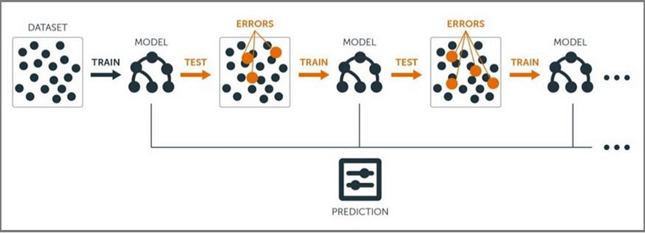
CatBoost algorithm
CatBoost is a gradient boosting algorithm that handles categorical data efficiently without manual preprocessing.
It uses ordered boosting to prevent data leakage by learning without future information.
Categorical features are encoded using ordered target statistics based on conditional probabilities.
Supports symmetric tree structures for faster training and improved model stability.
Handles missing values, offers automatic hyperparameter tuning, and supports GPU/CPU training.
Includes regularization techniques to reduce overfitting and works well for both classification and regression tasks.

Slide 12
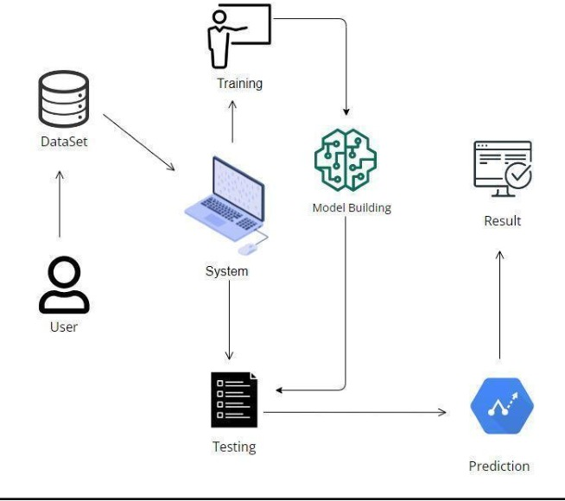
Workflow of System
.
Enables real-time tracking of mobile usage for immediate detection of addictive behaviors.
Uses objective device data (e.g., screen time, app usage) to eliminate self-report bias.
Automated and scalable, capable of analyzing large datasets efficiently.
Supports early detection and proactive intervention to prevent addiction escalation.
Delivers personalized alerts and recommendations based on user behavior patterns.
Offers continuous monitoring, adapting to individual usage habits for more accurate assessments.

Slide 13
Planning
..
Initial data collected through structured surveys, questionnaires, and mobile usage tracking tools.
Preprocessing involved cleaning data, handling missing values, encoding categorical variables, and scaling.
Planned to implement Decision Tree, Random Forest, and CatBoost models for prediction and comparison.
Evaluation planned using accuracy, precision, recall, F1-score, and confusion matrix for model performance.
Followed a structured ML pipeline: Data Collection → Preprocessing → Training → Evaluation → UI Deployment.
System planned to be scalable and capable of real-time analysis with minimal manual intervention.
A web interface using Django was planned to make the model accessible and user-friendly.
Ensured focus on data privacy, ethical usage, and secure handling of sensitive user information.

Slide 14
System Requirements
Software Requirements:
Operating System : windows 10/11
Coding Language : Python 3.12.0
Frontend : HTML ,CSS ,JavaScript
Backend : Django,Python,
Hardware Requirements:
Input devices : Keyboard, Mouse
Monitor : 15’’LED
RAM : 8GB
Hard Disk : 500 GB

Slide 15
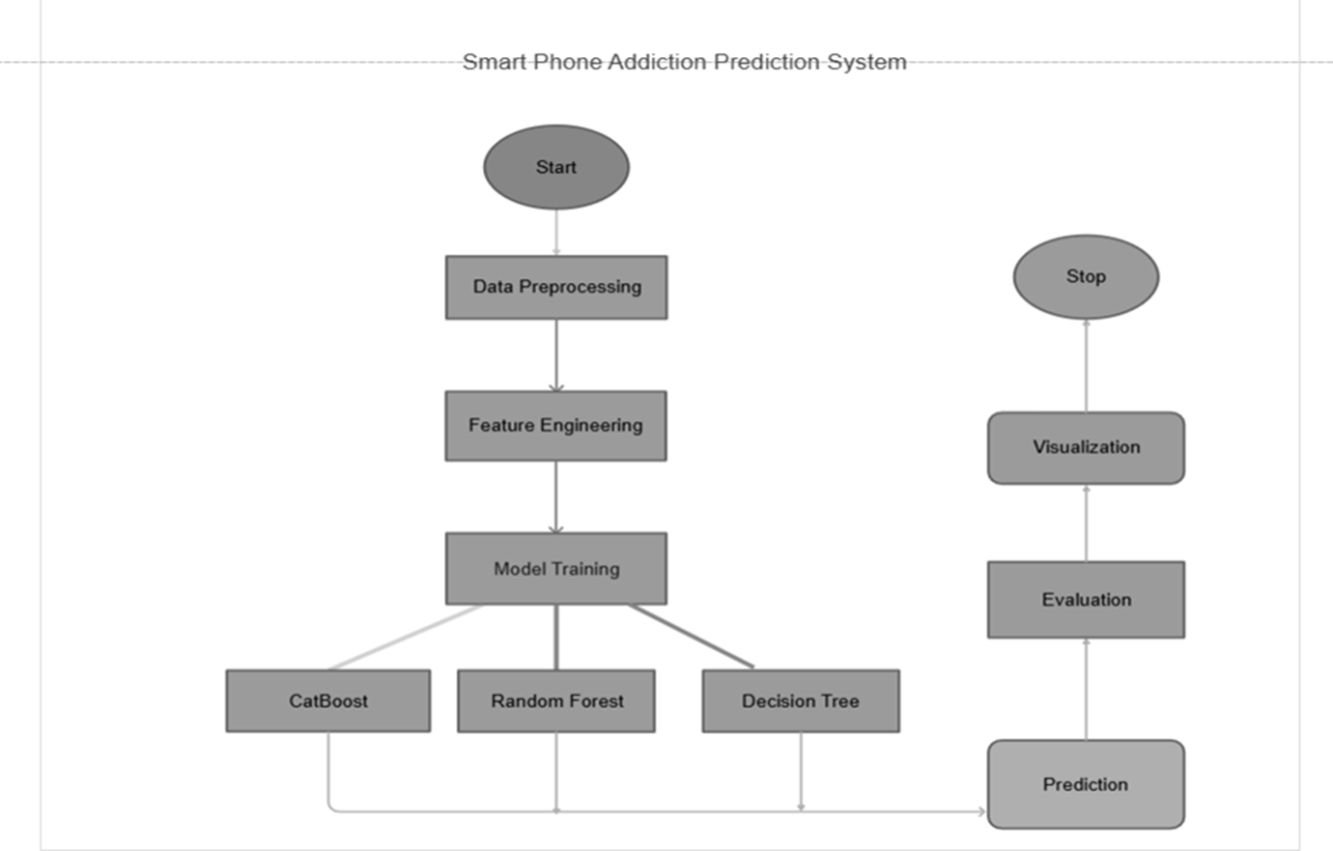
Designing
System Architecture

Slide 16
Designing
Data Collection
Data is collected using structured surveys, questionnaires, and mobile usage tracking tools. It includes:
Daily screen time, app usage, late-night use and Social media engagement
Academic performance, sleep quality, stress, anxiety, and attention span
Data from diverse student backgrounds to improve prediction accuracy
Data Preprocessing: Ensures quality and consistency before training. Key steps:
Handling missing values (mean/mode for numerics, frequent category for categoricals)
Removing duplicates and irrelevant entries and Outlier detection using Z-score or IQR methods
Feature encoding (One-Hot/Label Encoding)
Scaling using Min-Max or Standardization methods

Slide 17
Designing
Model Training
The dataset is split into training and testing sets (typically 80:20).
Models used:1)Decision Tree, 2)Random Forest, 3)CatBoost (selected for final use)
CatBoost is chosen for its high accuracy and native support for categorical data.
Hyperparameters are tuned using cross-validation to improve performance.
Models are trained to classify addiction levels: Low, Medium, High.
Model Evaluation
Trained models are tested on unseen data to evaluate generalization ability.
Performance is measured using the following metrics:
Accuracy: Overall correctness of predictions.
Precision: Correct positive predictions out of total predicted positives.
Recall: Correct positive predictions out of total actual positives.
F1-Score: Harmonic mean of precision and recall.
Confusion Matrix is used for visual evaluation of classification results.
Evaluation results are compared to select the best-performing model.

Slide 18
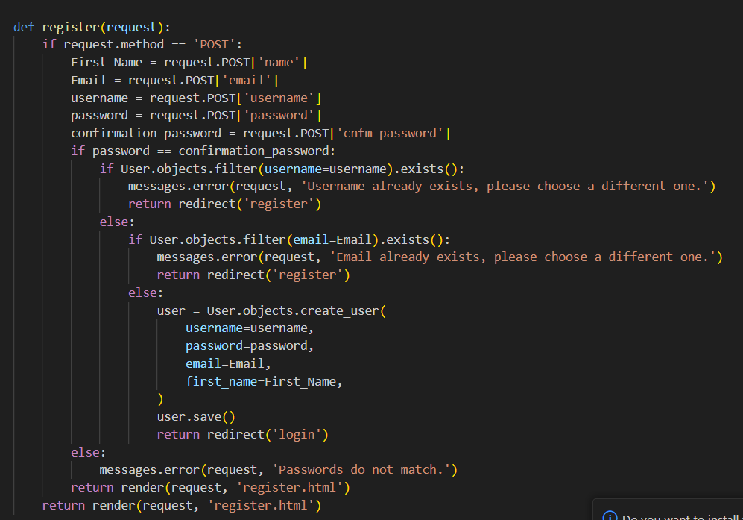
Implementation
Frontend: HTML, CSS, JavaScript
Backend: Python, Django
Admin:
Admin has the entire data about the user who has login
to website
Login: Admin must login to the website and
interface will be visible only after correct credentials
Upload Dataset: Admin has the access to upload
the dataset by clicking the upload and split button.
Performance analysis: Analyse performance of each
algorithm which was used in the model like
accuracy, precision, recall, F-score and confusion Matrix

Slide 19
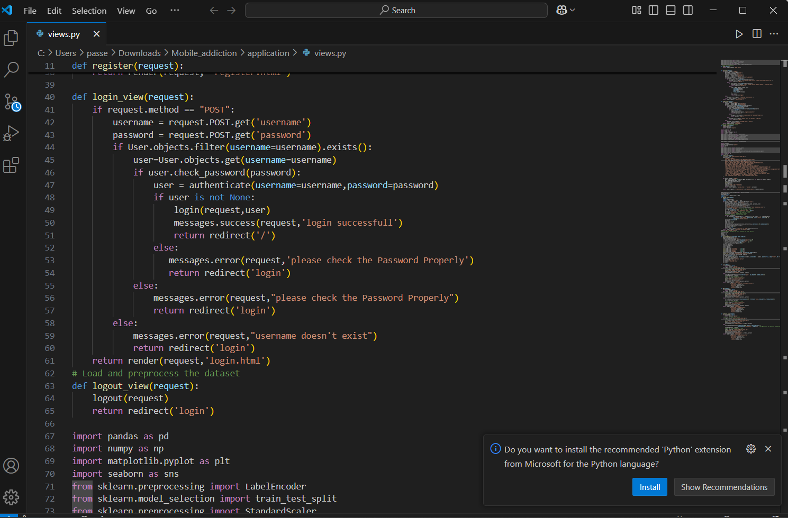
Implementation
User
Register: when the user access the website, who
must register by giving the valid credentials.so that the data
can be store in database for future access.
Login: after the Registration user can login by giving
the valid username & password.
Prediction: after successful login user can predict the
addiction levels by clicking the precit button. after clicking
the button the user complete the survey questions which are visible
in the interface. After filling the survey click the submit button.
Results and Feedback: The output will show prediction levels as
Low, Medium, High and gives the necessary suggestions according to the result.

Slide 20
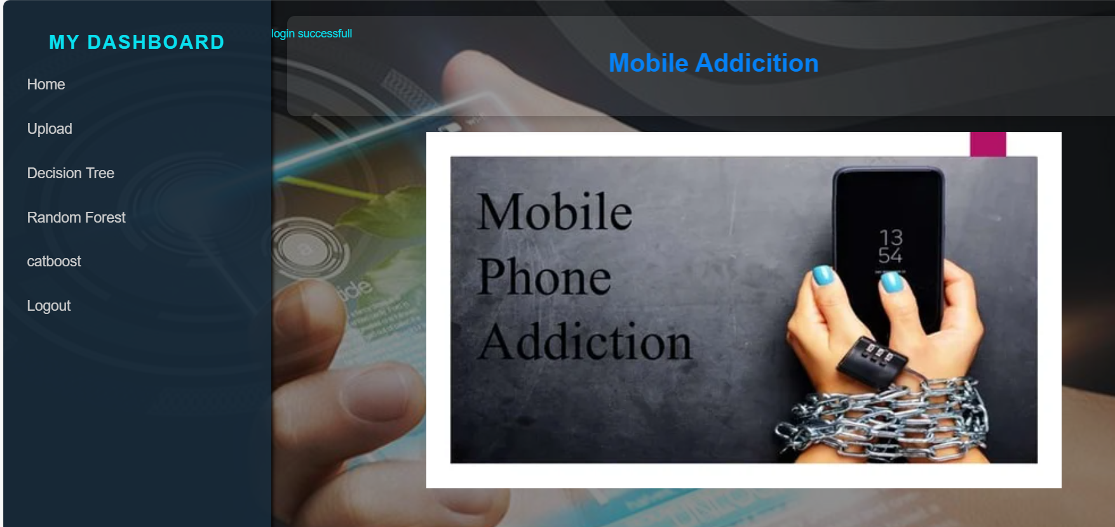
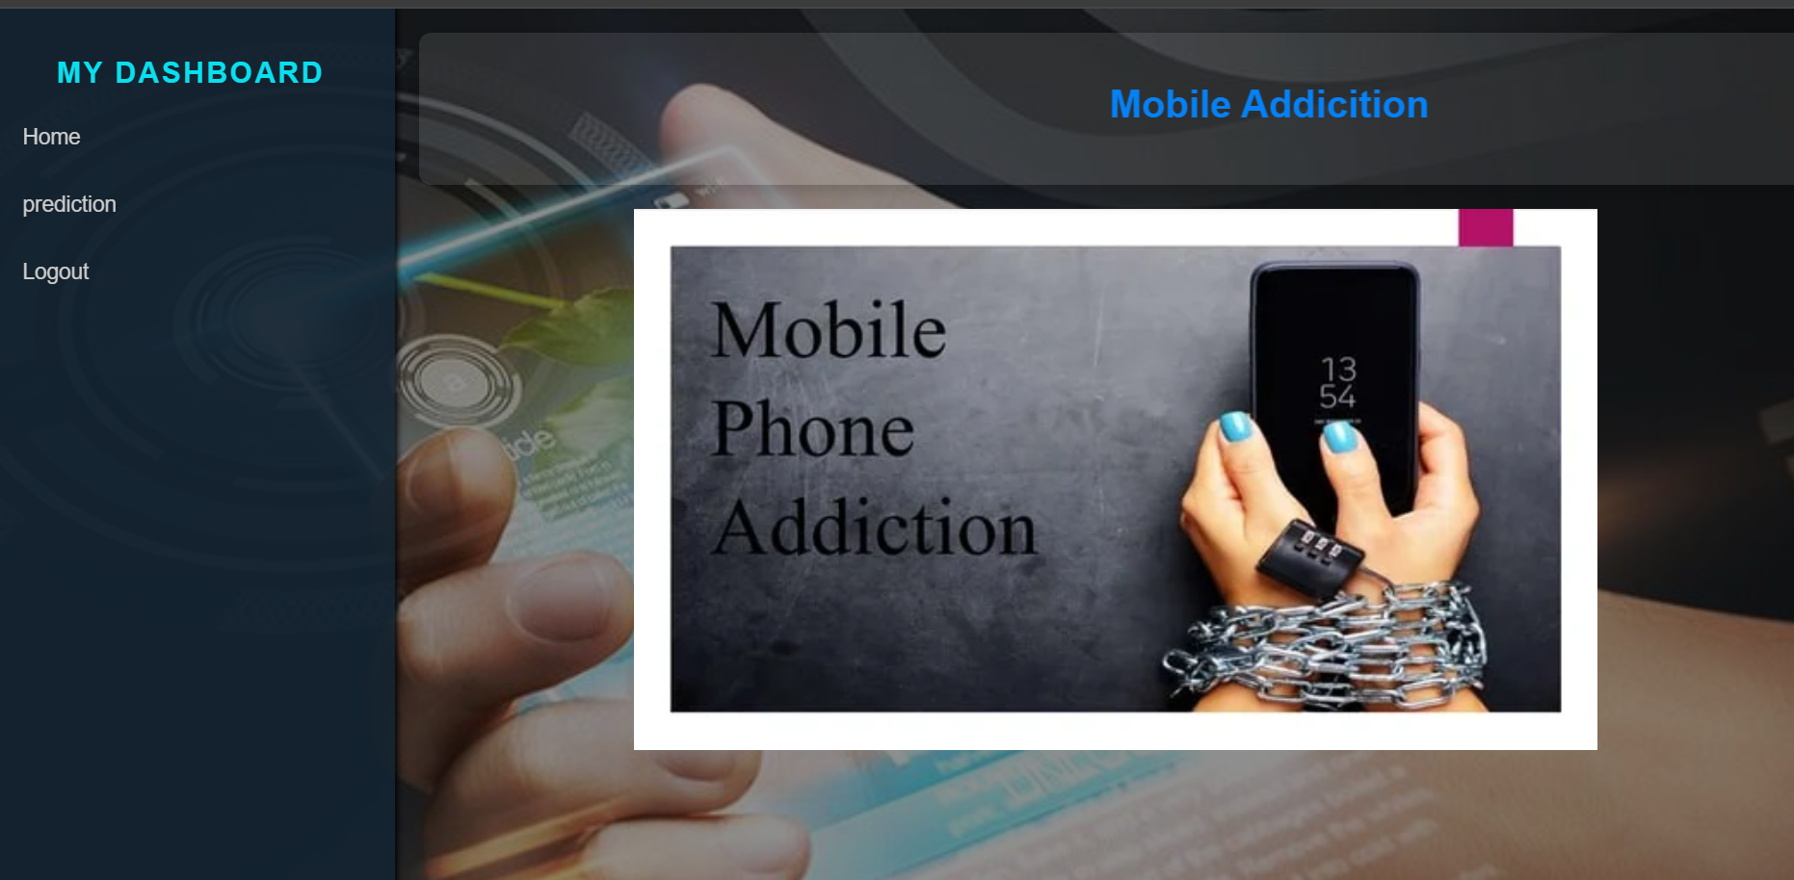
Results
Admin Interface User Interface

Slide 21
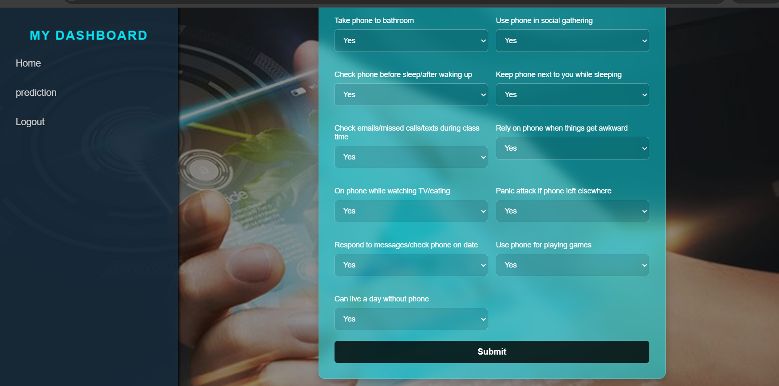
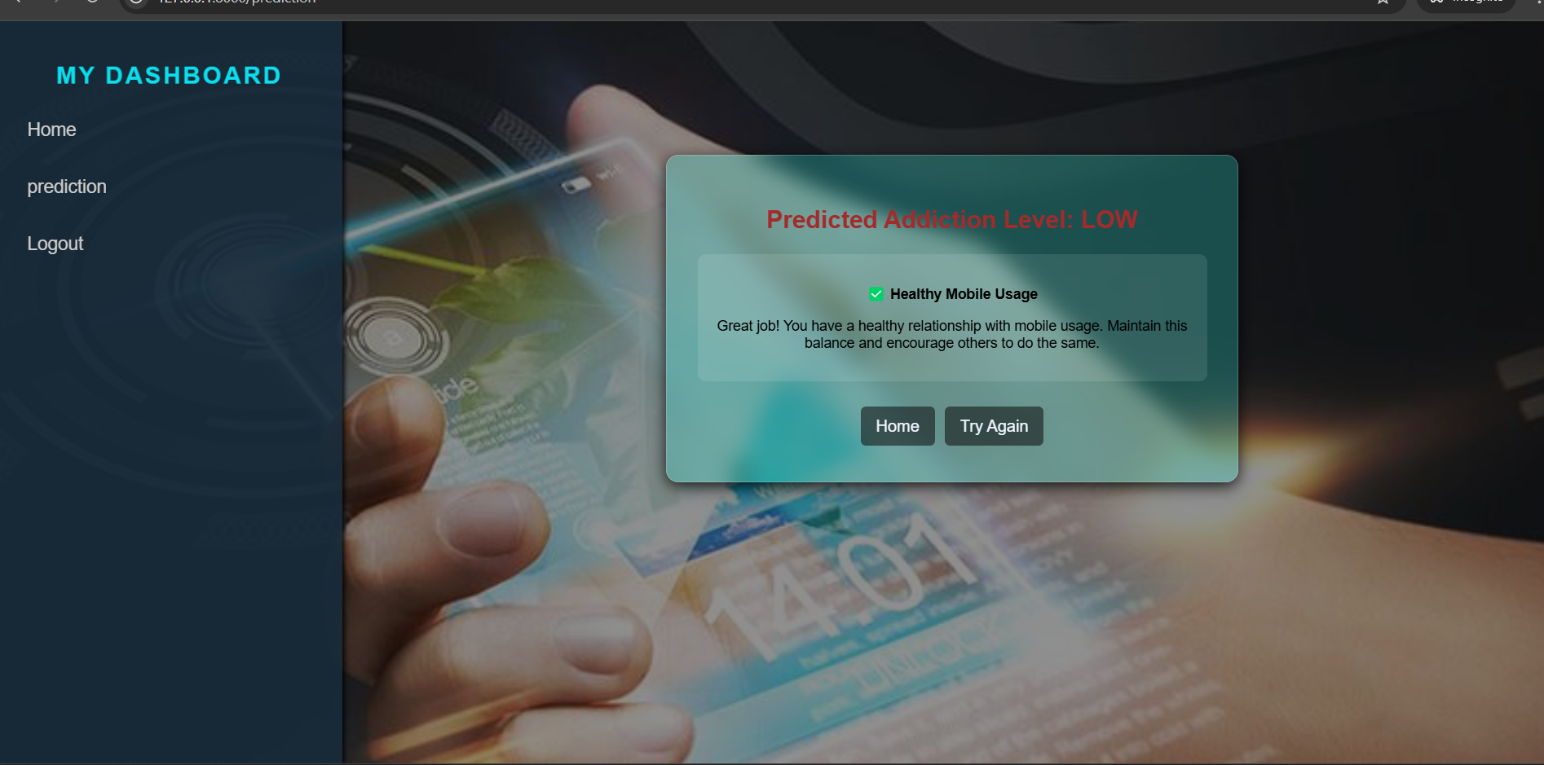
Results
Questionnaire Output

Slide 22
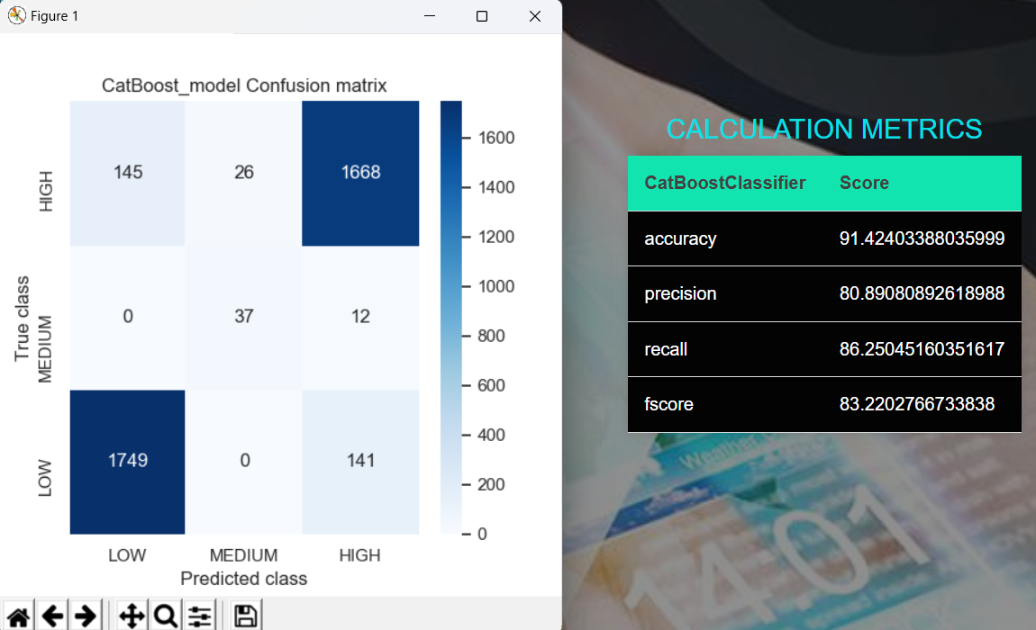
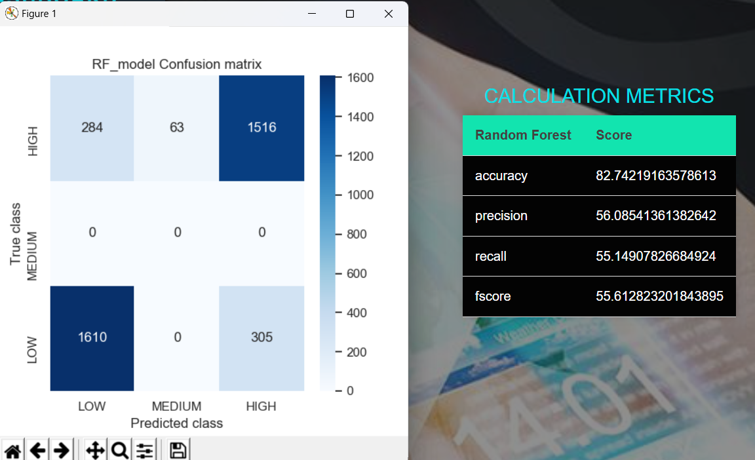
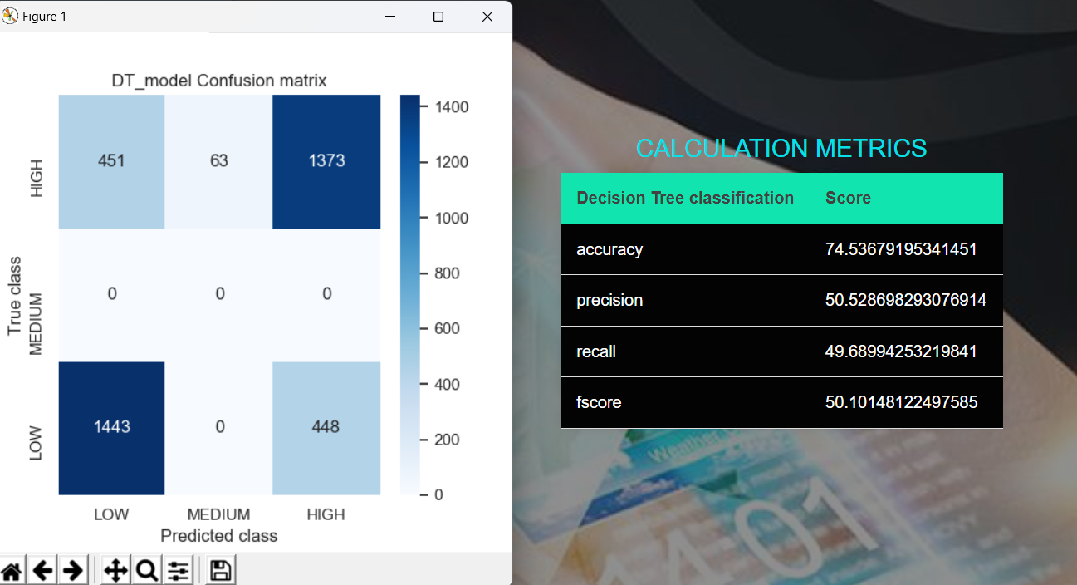
Results
1.ewdfcdfvc 2.
3. performance analysis
1.CatBoost Classifier
2.Random Forest
3.Decision Tree

Slide 23
Conclusion
In conclusion, the proposed ML-based predictive model for mobile addiction offers a data-driven, scalable, and efficient solution to identify and address mobile addiction patterns.
By utilizing machine learning algorithms, the system provides real-time monitoring, personalized predictions, and actionable insights based on user behavior.
Unlike traditional methods, which often rely on self-reported data or manual interventions, this system delivers objective, automated, and timely assessments that can proactively guide users towards healthier mobile usage.
With its ability to scale, provide tailored recommendations, and evaluate model performance through various metrics, the system presents a promising approach to tackling the growing concern of mobile addiction, fostering better mental health, and improving well-being in a technology-driven world.

Slide 24
References
Choi, Y., & Park, H. (2019). "Mobile addiction and mental health problems among adolescents." Journal of Child and Adolescent Psychiatric Nursing, 32(4), 181-188.
Chen, L., & Zhao, S. (2018). "Behavioural prediction model for mobile app addiction using machine learning." Computers in Human Behaviour, 81, 183-190.
Przybylski, A. K., & Weinstein, N. (2017). "Can you connect with me now? How the presence of mobile communication technology influences face-to-face conversation quality." Journal of Social and Personal Relationships, 34(4), 626-643.
Kuss, D. J., & Griffiths, M. D. (2017). "Social networking sites and addiction: Ten lessons learned." International Journal of Environmental Research and Public Health, 14(3), 311-319.

Slide 25
Thank You!!!

